Slide 1
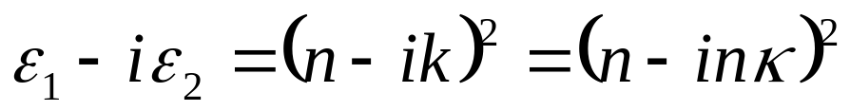
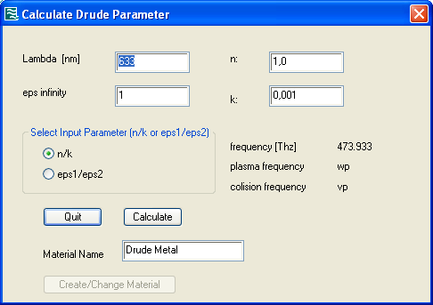
Macro: Calculate Drude Parameter for Optical Applications
In Nanooptics, it is often required to used a negative real part for the permittivity of metals. Furthermore the material parameter are usually given in terms of the refractive and absorption index n and k, respectively. This macro determines the complex permittivity out of a given set of parameters and calculates the Drude parameters of this values for a user given wavelength. The following relation holds:

